Slide 1
Web Programming Bootcamp
Yariv Doron , 2017

Slide 2
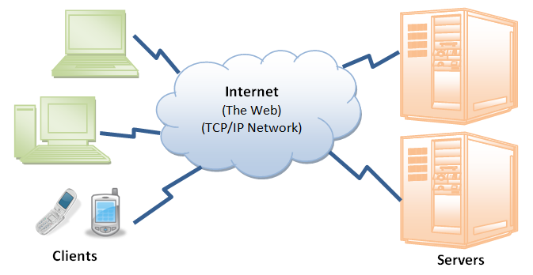
Anatomy of a website
Web servers store HTML files, pictures, movies and other file types.
It is connected to the internet, and awaits requests.
When a request for a page comes from a computer – the server will respond by forwarding all the relevant pages and files.

Slide 3
Anatomy of a website
Some terminology:
Front End : everything that the client sees and interacts with (HTML page, interface). This is where we are going to focus today.
Back End: computations and processes in the background. The client has no access to it. Usually happens in the server, before the result is “spit out”.

Slide 4
Anatomy of a website
HTML: Hypertext Markup Language. A simple way of placing elements on the page (headers, text, video player, etc.)
CSS: Cascading Style Sheets. The designing component of the page (colours, fonts, positioning, layout, animation)
JavaScript: an object-oriented computer programming language. Responsible for the interaction with the page (clicks, buttons, events, processing information, etc. )

Slide 7
Let’s get to work…
Download Brackets.io
Install
Recommended: install Chrome browser as Brackets.io works better with it.
Steps in creating your first file:

